Slide 1

Data Analysis
Course: BIAM110- Introduction to business analytics
Created by: Zinah Al-jelihawi
Professor: Ernest Green
Date: 10/22/2022

Slide 2
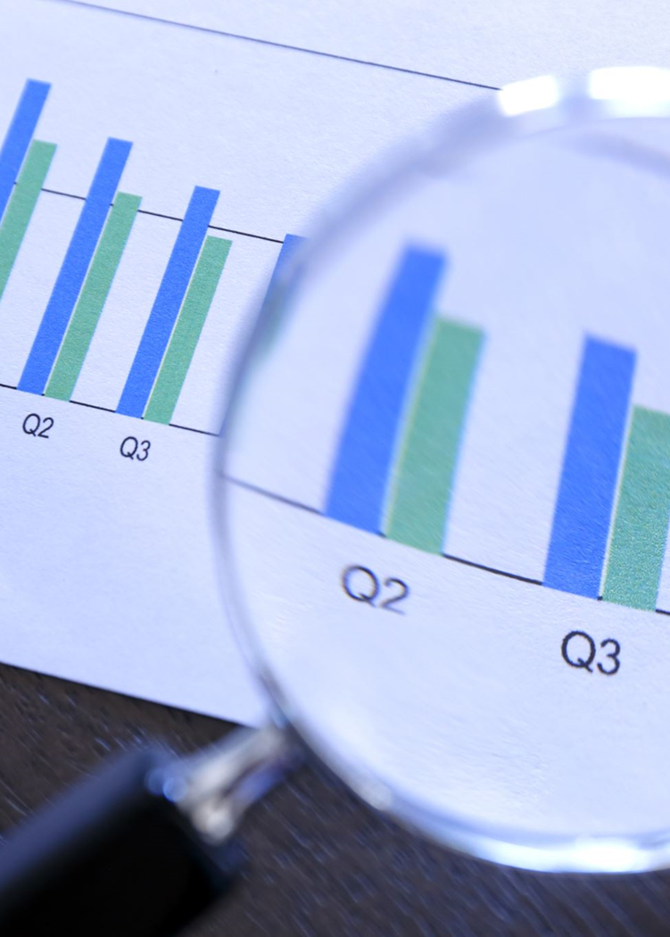
The value of using data analysis
It reduce decisions of uncertainty by identifying opportunities and threats
Define knowledge and performance goals
Ability to unlock massive data and create data mining
Make critical business decisions and identify growth improvement opportunities
Technology has spurred and automation processes depending on data
Data collected from customers, products, environment and competitors to create necessary decisions
Amazon has always been very informative and creative when it comes to utilizing big data and create a powerful system that are easy to manage, safe and accurate. That’s why I am following up with my presentation to show how is hiring a data analytics team that has a great background knowledge in utilizing data and technology for the benefit of your company and customers.

Slide 3

Using Data to Create a Competitive Advantage
Political factor: that deals with the political environment in which the business is located also global and international relations
Economical factor: that provides critical direction of business with the economy of the country
Social factor: have great impact on business with different geographics and people culture, traditions and mindset.
Technological factor: that upkeep with technology changes and advancements to sustain business growth
Environmental factor: is the climate change and usage of natural resources are important for business plan
Legal factor: that keeps up the boundaries between business and government to adhere to rules and regulations of their business location

Slide 4
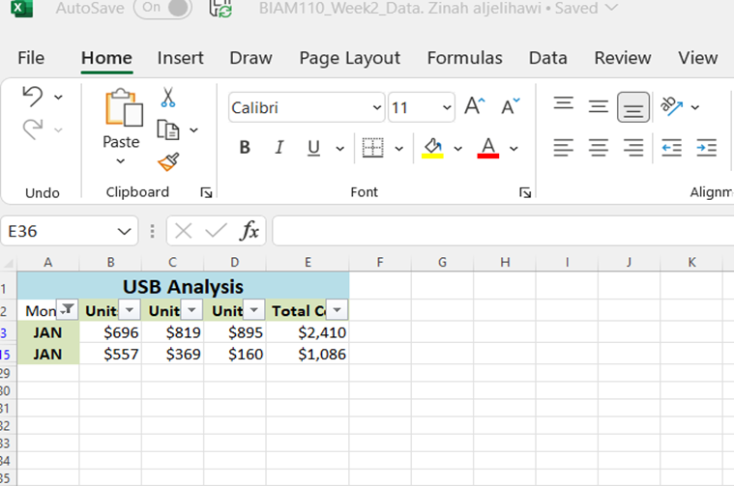
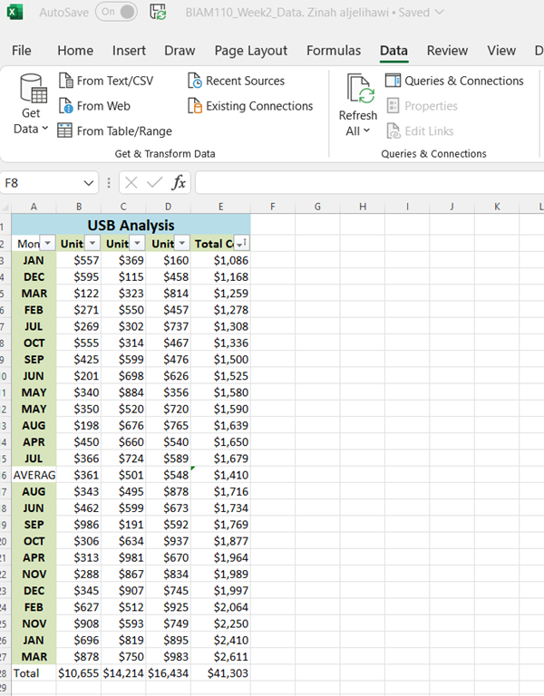
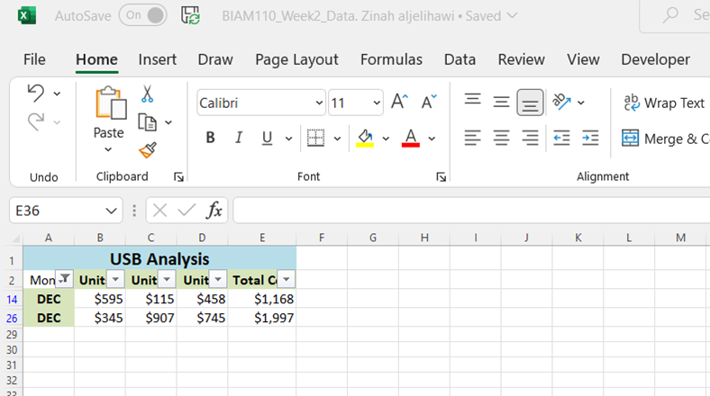
Microsoft Excel Features
The most important role of this tool is creating presentations
Sorting data by ascending or descending order
Filtering data by category
Accurate comparisons and analysis options
Ready to use formulas that are easy to apply
Compatibility with other business applications

Slide 5
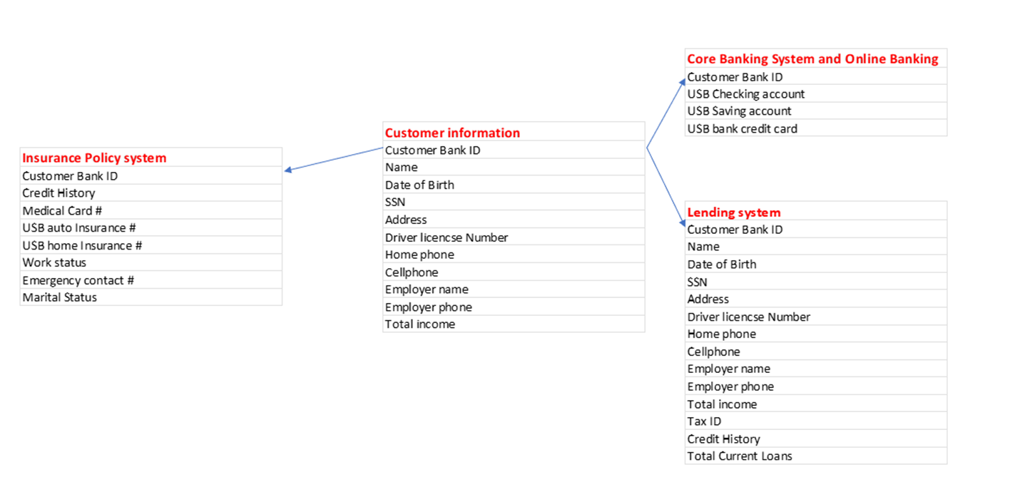
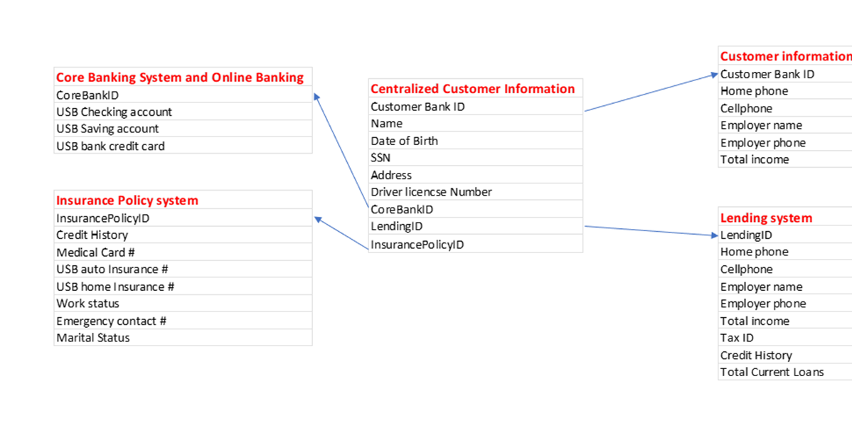
Centralized system for big data
Several challenges could face the organization when data is being collected poorly
Creating a centralized system where all basic information is connected cross departments.
Easy to facilitate the work quality and ensures that information is up to date
Can be managed by less people and therefore protecting information
Protection can be applied from one system to all systems
ensures flexibility, speed in data input and management, low cost on maintaining

Slide 6

Data integration tools
Increasing business strategy method that is important to business digital transformation
Data integration tools consist of probability, hypothesis testing and normal distribution statistical tools
Probability and statistics play a vital role in business decisions
Probabilities are used to identify the risk a business can take in making decisions
In a probability case the risk is the factor that will distinguish the outcome that may differ from the expectations

Slide 7
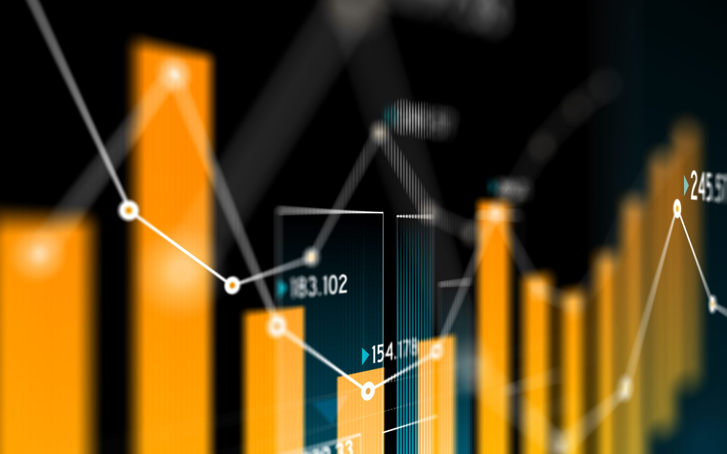
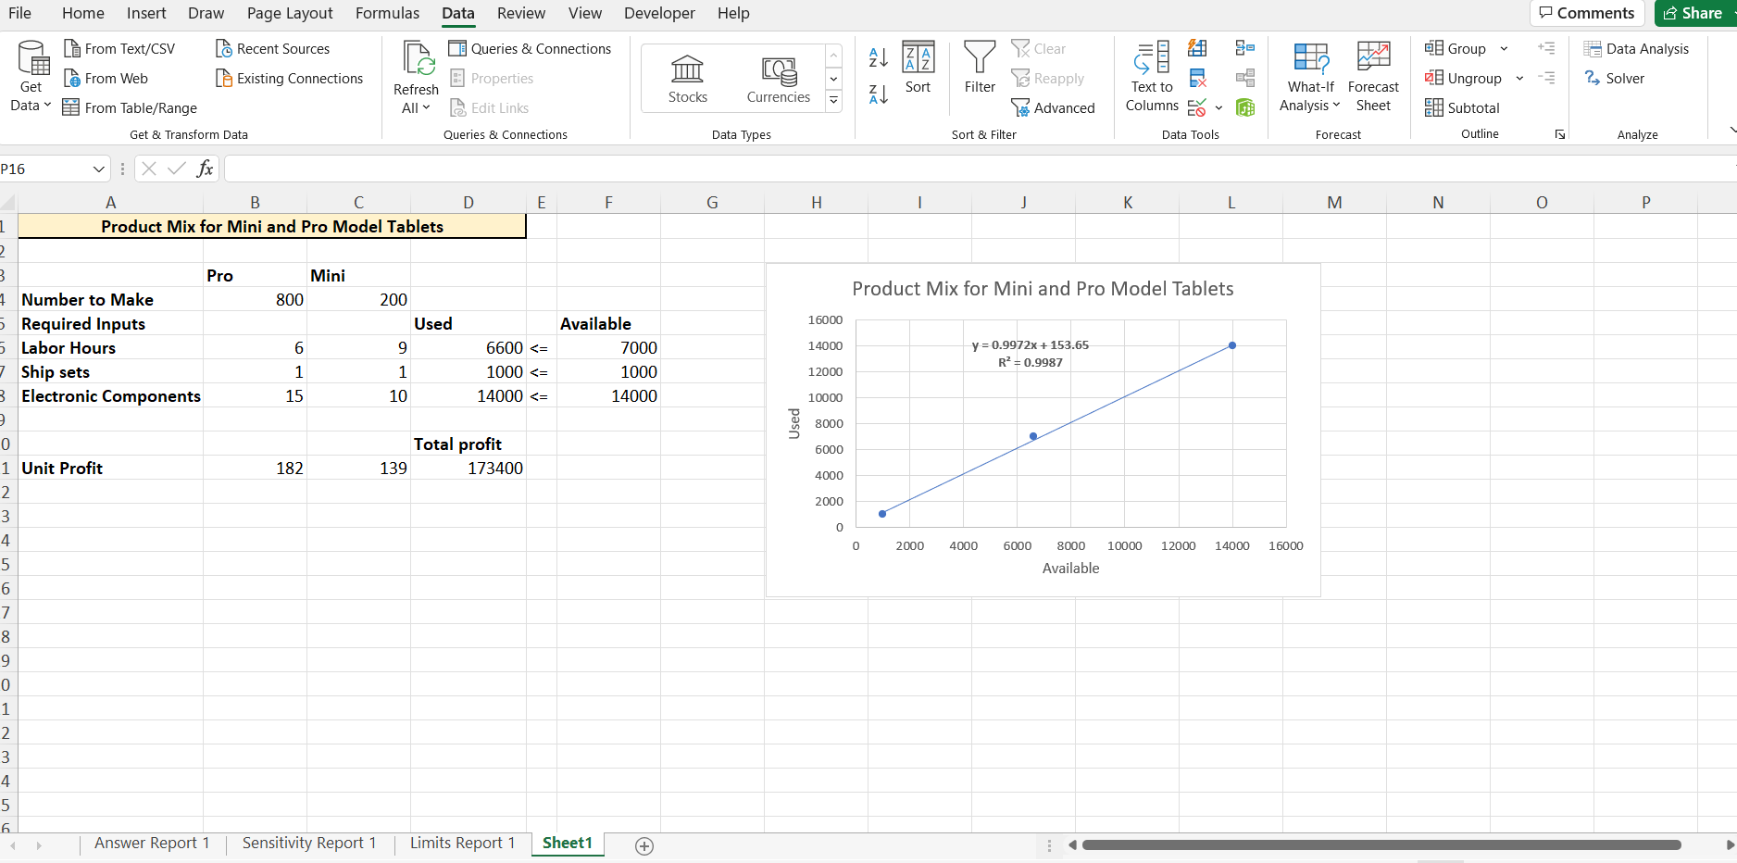
linear regression and optimization techniques
Linear regression is linear approach of modeling the relationship between different variables
Linear regressions are used to evaluate, estimates and find trends in the organization
Companies rely on predictions of future outcomes by using linear regression and optimization tools in finding the trends and common data that a business will plan their business accordingly
Using excel features to solve critical data input and create sophisticated reports and visual business regression optimize line of the inputs

Slide 8

Data analytic tools using R
This statistical tool shows us how one variable can influence the other
useful way to detect correlations between variables
Information from the simple regression using R can aid companies to make responses and inputs on future trends forecast and management decisions
It calculates the data and plot it in an X and Y relationship
The plots direction will represent the relationship that these two variables have, the two variables will share a slope that represent the increase or decrease in the line. The plot will also be able to show us how solid bond there is between the variables
This type of data can enhance the optimization and forecasting of the company’s future outcomes by simply trying different data inputs and see the correlations and differences in the outputs
For example, we can use to find the relation between happiness and income using the lm command in the R tool : income.happiness.lm <- lm(happiness ~ income, data = income.data)

Slide 9
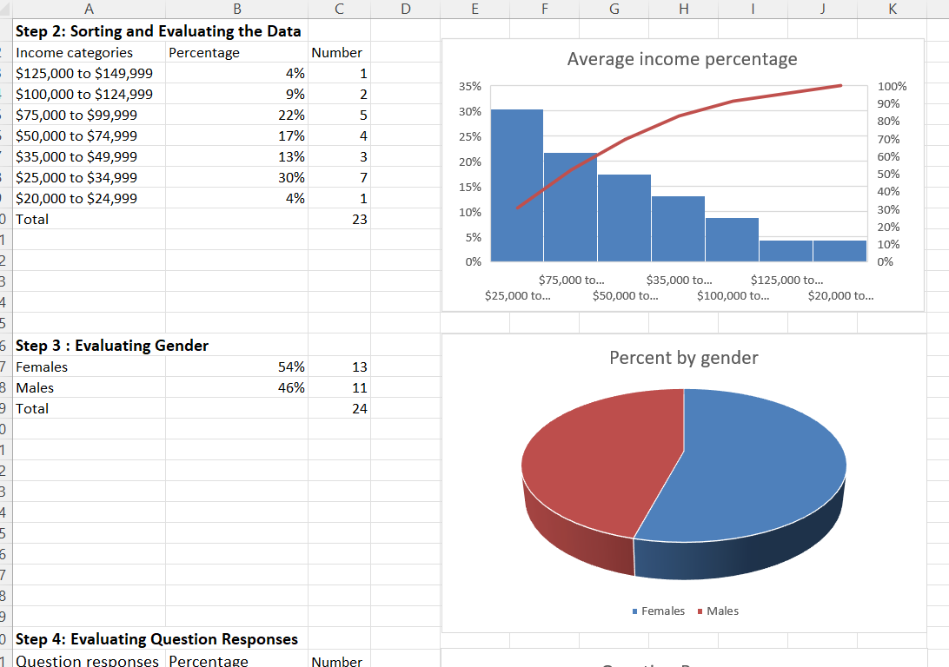
The risks of not using data visualization
Data can be misleading
Lack of understanding to make critical decisions
Lack of numerical literacy among audience
Poor presentation skills
Losing time trying to understand the data presented
Poor decisions and quality performance
Only small decisions can be concluded with no visualizations to show the statistical trends and correlations among data.

Slide 10

lessons learned
1 | 2 | 3 | 4
Data analysis helps many businesses prosper and grow if used precisely | Having the idea of how to organize data analytics team to get the most out of your data investments is essential | Knowing how to select the right tools for your data analysis is most important start for the business | Linear regression tools like R or Excel tools are an essential to data analytics to create reports and graphs visualizations.
5 | 6 | 7 | 8
How to utilize competitive advantage strategies using data from the five factors political, social, technological, economical and legal | Statistical probabilities are an important tool in data analytics that identify the risks or benefits a business can take with precise measurements | Using a centralized system for big data ensures fast and easy excitability, usability, and protection to business data | Data analytics use probabilities and statistical tools to optimize and forecast information to manage business future

